Slide 1


Website Checker System
An web application to test your website performance, quality,
experience, technology and contact.
SUPERVISOR：Nguyễn Huy Hùng
MEMBERS: Nguyễn Trương Thúy Vi (LEADER)
Lê Ngọc Trường
Nguyễn Đức Trịnh
Trần Phúc Anh

Slide 2


INTRODUCTION
01
Brief description
Problem definition , proposed solution, boundary
AGENDA
02
IMPLEMENTATION
Design & Implement system
03
OUTCOME
Value and Challenges
04
FUTURE PLAN
Our plan in the future

Slide 3

01
INTRODUCTION
Brief description
Problem definition , proposed solution, boundary

Slide 4

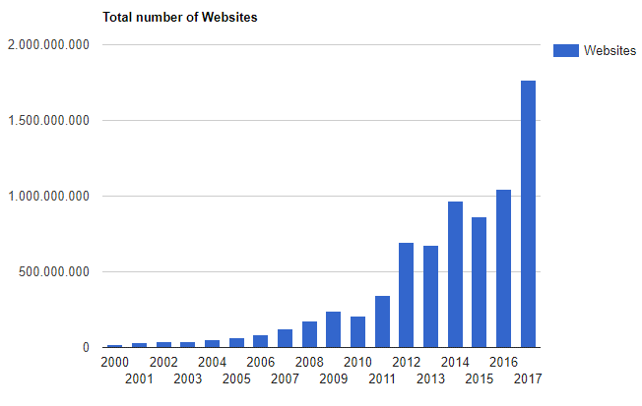


INTRODUCTION
The higher a website's site quantity, the more complicated the test process is.
Assuming entire processes are manual operations, it's certainly costly, time-consuming.
In many cases, there are underlying issues: JavaScript errors, bad server behavior, responsive on multi devices.
CURRENT SITUATION
How the website owner ensure that entire their website run smoothly or function correctly as they expected?

Slide 5


INTRODUCTION
PROBLEM DEFINITION
Cannot ensure entire website run smoothly or function correctly as expected.
Broken links, broken pages or missing files can’t be immediately detected.
Some resources in website content are not up to date or no valid anymore.
Technical properties: server behavior, page redirection are not clearly displayed.
So that, Website owner not able to track the quality of their website in details.
Even in critical information, spelling and grammar mistakes still exist.
Reduce the effectiveness of product sale, business ads, business’s trademark.
A poor quality website reflects on an entire brand.

Slide 6




INTRODUCTION
OUR PROPOSAL
WCS
Generate Sitemap
Test Quality
Manage Web’s Dictionary
Test Experience
Manage Warning Word List
Test Technology
Setting General standard
Test Content
Manage Staff Permission
Manager
Staff

Slide 7
TEST FUNCTIONS
Build Sitemap
Spelling Test
Grammar Test
Broken Link Test
Broken Page Test
Missing File Test
Prohibited Test
JavaScript Error Test
Favicon Test
Cookie Law Test
Server Behavior test
Mobile Layout Test
Speed Test
Page Test
Contact Detail Test
Redirection Test

Slide 8


INTRODUCTION
BOUNDARY
System only support Web Owner to test English websites.

Slide 9
02
IMPLEMENTATION
Design and Implement system

Slide 10
IMPLEMENTATION
SYSTEM ARCHITECTURE
We know that a web application is used for testing,
in which the test process is quite long (depending on the test function).
Notes:
After analyzing the software requirements,
We know that a web application is used for testing, in which the test process is quite long (depending on the test function). We have to choose a framework for one page support (Ajax and Cached all)

Slide 11
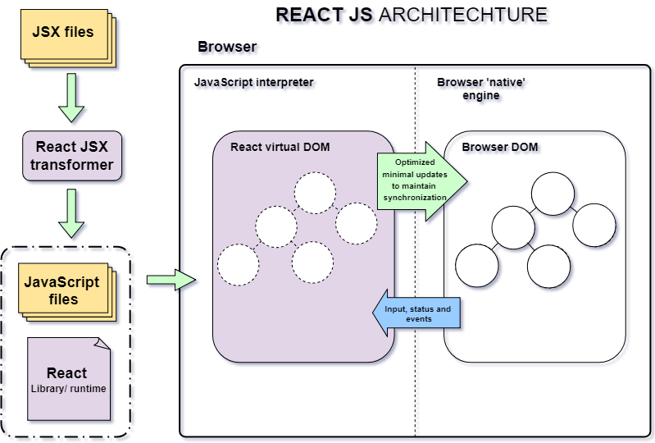

IMPLEMENTATION
SYSTEM ARCHITECTURE
Notes:
After analyzing the software requirements,
We know that a web application is used for testing, in which the test process is quite long (depending on the test function). We have to choose a framework for one page support (Ajax and Cached all)

Slide 12
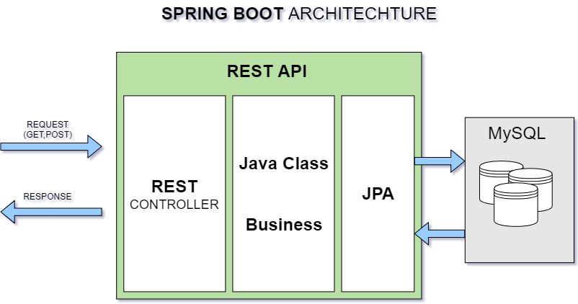

IMPLEMENTATION
SYSTEM ARCHITECTURE
Notes:
After analyzing the software requirements,
We know that a web application is used for testing, in which the test process is quite long (depending on the test function). We have to choose a framework for one page support (Ajax and Cached all)

Slide 13
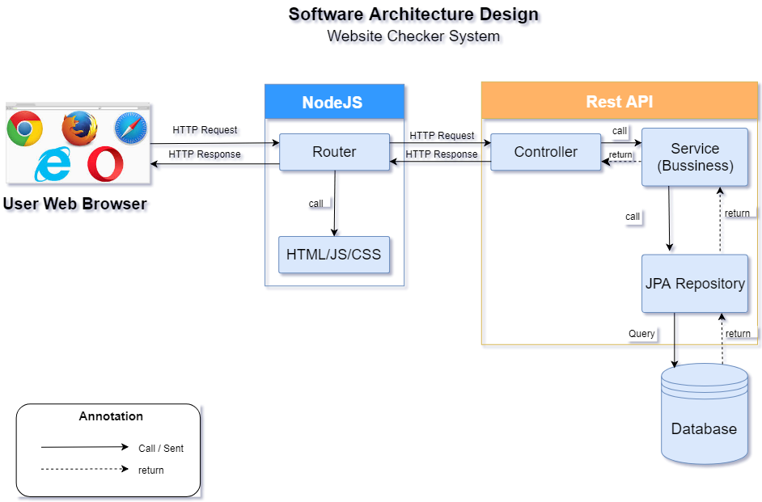
IMPLEMENTATION
SYSTEM ARCHITECTURE
Notes:
After analyzing the software requirements,
We know that a web application is used for testing, in which the test process is quite long (depending on the test function). We have to choose a framework for one page support (Ajax and Cached all)

Slide 14



IMPLEMENTATION
ALL OF MAIN FEATURES
A useful assistance supplies a general view of entire web's link structure.
A feature for staff to determine page to test
Quality Test
Experience Test
Technology Test
Content Test
BUILD SITE MAP
PAGE OPTION
TEST FUNCTION

Slide 15
What is a SITEMAP?
A list of pages that are contained in a website that is accessible to website crawlers or users.
A useful assistance supplies a general view of entire web's link structure.
Display the relationship between various pages, demonstrating the way that the website is organized, how it can be navigated, and how it is labeled.
BUILD SITE MAP

Slide 16

BUILD SITEMAP
Issue & Solution
1. Represent data organization: link structure of website.
Build Directed Graph
The vertices represent web pages
The directed edges represent links from one page to another.
2. Visualize graph by drawing image on canvas for webmaster. Display type of each link: internal (backlink) or external, and its status.
Apply Breadth-First Search

Slide 17
BUILD SITEMAP
Implementation
a
b
c
d
e
f
g
h
i
Queue
i
g
f
d
c
b
a
URL Map
(a,0)
(b,1)
(c,2)
(d,3)
(e,4)
(f, 5)
Type List
1
1
1
1
2
1
1
2
1
(g, 6)
(h, 7)
(i, 8)
Link List
a
b
c
d
e
f
g
h
i
Graph
[0]
b
c
d
MapId
0
Vertice
0
[1]
e
f
g
[5]
a
Current_URL
a
[2]
[6]
Reference_URLs
[3]
g
h
i
[7]
b
c
d
[4]
[8]
d

Slide 18
BUILD SITEMAP
Implementation
a
0
b
c
d
1
2
3
e
f
g
h
i
4
5
6
7
8
0
2 3
4 5 6 7 8
1
1 1
2 1 1 0 2 1
id
type
0
1 1
1 1 1 3 3
1
1 1
1 1 1 0 3 3
a
b c d
e f g “” h i
code
gen
url

Slide 19
BUILD SITEMAP
Implementation
a
0
b
c
d
1
2
3
e
f
g
h
i
4
5
6
7
8
Directed Graph
a
b
c
d
e
f
g
h
i
BFS tree

Slide 20
BUILD SITEMAP
Implementation
Drawing on canvas

Slide 21







BUILD SITEMAP
Process
2. Go to Manage
Website Screen
1. Log in system
3. Add Website
4. Build Sitemap
Manager
Manager UI
Website List
Alternative Scenario
3. Choose Website
4. Get Latest Version
4. Build Sitemap

Slide 22


Slide 23
A feature for staff to determine page to test
PAGE OPTION

Slide 24
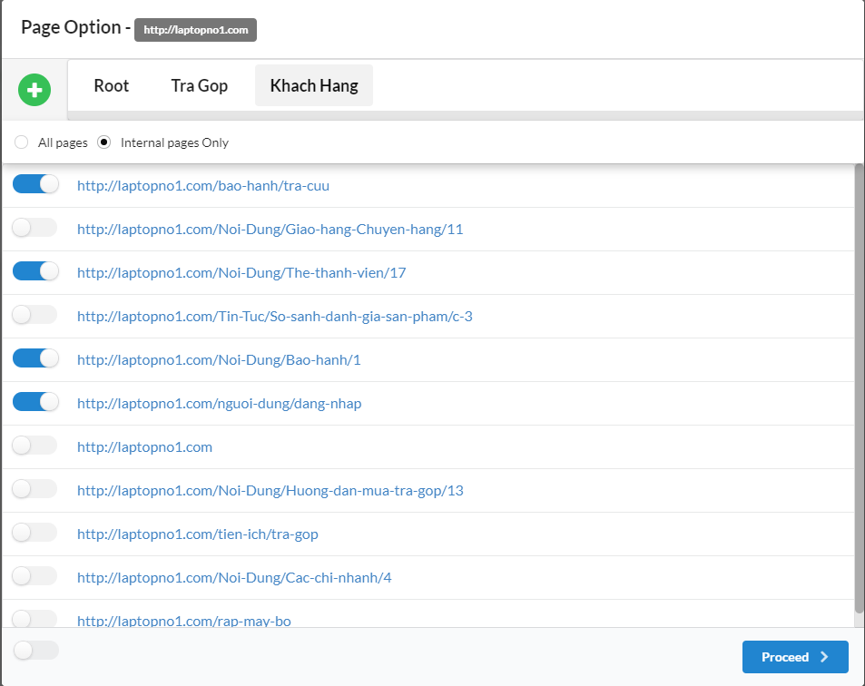
PAGE OPTION
DETERMINE PAGE TO TEST
Page option makes it much easier to
meet multiple testing needs
A feature for staff to determine page to test
The function test for staff
PAGE OPTION
TEST FUNCTION

Slide 25
Quality Test
Experience Test
Technology Test
Content Test
TEST FUNCTION

Slide 26

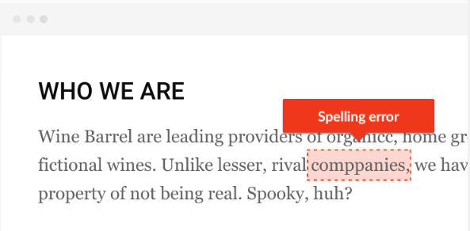
SPELLING TEST
Even in critical information, spelling and grammar mistakes still exist.
Detect spelling mistakes
Give options for users
View suggestions
Choose an alternative word
Or confirm ignore those mistakes.
User’s responding is collected and used for increasing the accuracy of spelling test processor.

Slide 27
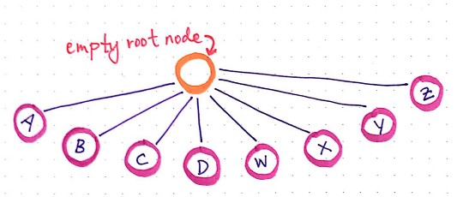
SPELLING TEST
Issue & Solution
1. Detect spelling mistake
Apply Trie Tree to build predefined dictionary
h
t
2. Suggest alternative words
Generate cases to find correct similar words
a
o
Happy
p
r
t
m
Happ
Hap-
Harp
p
p
a
3. Performance
y
t
Recursively search on Trie tree
o

Slide 28

SPELLING TEST
Process
2. Go to Spelling Test Screen
3. Choose pages
option
1. Login as Staff role
Page Option
Popup
Staff
Spelling Test Screen
4. Save
page option
Staff Page
5.Send test
command
7. Save results
6. View suggestion
Action: Learn / Ignore
Result table
Spelling Test
Screen

Slide 29

PAGE TEST
The following this test of a website included:
Title
Canonical URL
Status code
Notes:
- Page test là chức năng để kiểm tra các trang của website hiện tại đang có mã trạng thái hoạt động ra sao, tiêu đề và canonical url của mỗi trang website .

Slide 30
PAGE TEST
Process
2. Choose Page Test
3. Choose pages
option
1. Login as Staff role
Page Option
Popup
Staff
Pages
Test Page
4. Save
page option
Staff Page
5.Check
Pages
6. Save result
check result table
Pages
Test Page

Slide 31

CONTACT DETAIL TEST
This test detects the information contact of a website. WCS only check the information contact included:
Phone Numbers
Emails
Notes:
- Thông tin liên lạc trên website là một thông tin khá quan trọng giúp kết nối nhanh chóng giữa doanh nghiệp với khách hàng và doanh nghiệp vs nguồn nhân lực.
- Do đó hệ thống chúng tôi sẽ phát hiện số điện thoại và email được hiển thị trên website.

Slide 32
CONTACT DETAIL TEST
Process
2. Choose Contact Detail Test
3. Choose pages
option
1. Login as Staff role
Page Option
Popup
Staff
Contact Detail
Test Page
4. Save
page option
Staff Page
5.Check
Contact Detail
6. Save result
check result table
Contact Detail
Test Page

Slide 33

FAVICON TEST
A Favicon (or favorite icon) is a small image used to represent a website or webpage.
This test checks whether this website correctly defines Favicons, which are icons used to represent the website.
Notes:
- Favicon (biểu tượng ưa thích) là một hình ảnh nhỏ được dùng hiển thị trên website hoặc trang của website.
- giúp trang web trông chuyên nghiệp hơn và dễ nhận biết hơn khi làm việc với nhiều tab.
- Vì vậy hệ Thống chúng tôi sẽ kiểm tra favicon của website bạn và kiểm tra xem trang website nào đang bị thiếu Favicon do nhiều lý do

Slide 34

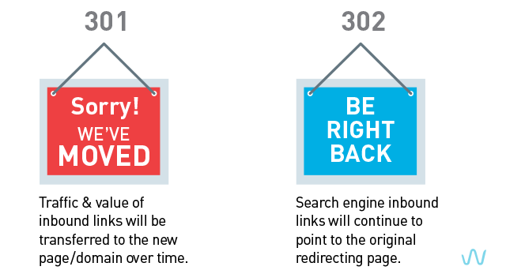
REDIRECTION TEST
A redirection is where a URL points to another URL.
Redirections are hard to identify manually. This test makes it easy to identify what redirections are in place.
Notes:
- Redirection là một URL trỏ đến một URL khác,
thường được sử dụng cho mục đích tiếp thị, bằng cách chuyển hướng một địa chỉ web ngắn và dễ nhớ đến một trang cụ thể.
Redirection khó có thể xác định bằng thủ công, test này giúp dễ dàng xác định những gì chuyển hướng đang diễn ra.
301 Redirects: Phương pháp này thông báo với người dùng và Google Bots rằng webpage hoặc website của bạn đã được di chuyển vĩnh viễn tới một địa chỉ mới.
Như mặc định – Đây là một phương pháp hữu ích
Trang đang được di chuyển hoặc thay thế
Tên miền được di chuyển vĩnh viễn ( Mua lại, đổi thương hiệu,…)
Trang báo lỗi 404 và nội dung hết hạn.
Canonical Tag: Thuộc tính này thông báo với Google Bots rằng nội dung ở trang mà nó hướng tới là nội dung gốc.
Khi phương pháp 301 Redirects không thể sử dụng hoặc mất quá nhiều thời gian
Nội dung trùng lặp nhưng bạn muốn người dùng nhìn thấy cả 2 pages
Trang chia ra làm nhiều pages ( Trang 1, 2, 3…. phân loại sắp xếp…)

Slide 35
REDIRECTION TEST
Process
2. Choose Redirection Test
3. Choose Pages
Option
1. Login as Staff role
Page Option
Popup
Staff
Redirection
Test Page
4. Save
Page Option
Staff Page
5.Check Redirection
6. Save Result
Check Result Table
Redirection
Test Page

Slide 36

MISSING FILE TEST
A missing file is a file used by a webpage (such as an image, document or stylesheet) that was not loaded for any reason.
Notes:
Missing file là tập tin được dùng bởi trang website (Như hình ảnh, tài liệu or css) mà nó không thể hoạt động bởi nhiều lí do.

Slide 37

MISSING FILE TEST
WCS only check 4 type included:
Image: .png, .jpg, . jpeg extension.
CSS: .css extension.
Document: .doc, .pdf, .ppt, xls extension.
Archives: .rar, .jar, .zip extension.
Notes:
Do đó hệ thống chúng tôi sẽ kiểm tra xem tập tin đó có hoạt động hay không hoặc tập tin đó bị rỗng
4 loại file gồm
- hình ảnh, CSS, tài liệu và file nén giúp trang web được hoạt động tốt hơn.

Slide 38
MISSING FILE TEST
Process
2. Choose Missing File Test
3. Choose Pages
Option
1. Login as Staff role
Page Option
Popup
Staff
Missing File
Test Page
4. Save
Page Option
Staff Page
5.Check Missing File
6. Save Result
Check Result Table
Missing File
Test Page

Slide 39
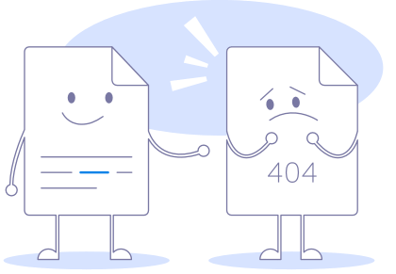

BROKEN LINKS & BROKEN PAGES TEST
A broken page is a page which appears to not work as expected.
A broken link is a link which fails to load a working page when visited.
Internal links and external link will be tested.
The function test for staff
TEST FUNCTION

Slide 40


BROKEN LINKS & BROKEN PAGES TEST
Broken Links
Broken Pages
HTTP Status Codes
Level 200 (Success) 203 : Non-Authoritative Information 204 : No Content 205 : Reset Content 206 : Partial Content | Level 400 (Client errors) 403 : Forbidden 404 : Not Found 405 : Method Not Allowed 409 : Conflict | Level 500 (Server errors) 500 : Internal Server Error 501 : Not Implemented 503 : Service Unavailable 504 : Gateway Timeout 505 : HTTP Version Not Supported 507 : Insufficient Storage 510 : Not Extended 511 : Network Authentication Required

Slide 41
BROKEN LINK TEST
Process
2. Choose Broken Links Test
3. Choose pages
option
1. Login as Staff role
Page Option
Popup
Staff
Broken Links
Test Page
4. Save
page option
Staff Page
5.Check
Broken Links
6. Save result
check result table
Broken Links
Test Page

Slide 42
BROKEN PAGE TEST
Process
2. Choose Broken Pages Test
1. Login as Staff role
3. Choose pages
option
Page Option
Popup
Staff
Broken Pages
Test Page
4. Save
page option
Staff Page
5.Check
Broken Pages
6. Save result
check result table
Broken Pages
Test Page

Slide 43

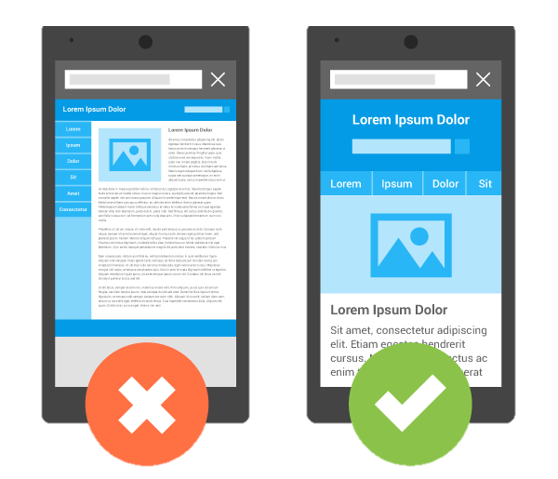
MOBILE LAYOUT TEST
Standard of the website on the mobile screen :
Support mobile version.
Support responsive web design (RWD).
Support pinch to zoom.
Support scroll horizontally.
Font-size : 16px.
Target-size : 44px X 44px.
he function test for staff
TEST FUNCTION

Slide 44
MOBILE LAYOUT TEST
Process
2.Choose Mobile Layout Test
3. Choose pages
option
1. Login as Staff role
Page Option
Popup
Staff
Mobile Layout
Test Page
Staff Page
4. Save
page option
5.Check
Mobile Layout
6. Save result
check result table
Mobile Layout
Test Page

Slide 45

PROHIBITED CONTENT TEST
Prohibited content is offensive and illegal content.
This test checks for the use of specific text that user wish to avoid.
Unwanted words will be predefined by Manager.

Slide 46
PROHIBITED CONTENT TEST
Process
2.Choose Prohibited Content Test
3. Choose pages
option
1. Login as Staff role
Staff
Staff Page
Prohibited Content
Test Page
4. Save
page option
5.Check
Prohibited Content
6. Save result
check result table
Prohibited Content
Test Page

Slide 47


COOKIES LAW TEST
Four main cookie types :
Strictly necessary cookies.
Performance cookies.
Functionality cookies.
Targeting cookies or advertising cookies
Notes:
Đảm bảo các tính năng được thực hiện đúng _ xác thực
Thu thập thông tin về cách người dùng truy cập_ khu vực nào được truy cập nhiều nhất
Tăng trải nghiệm người dùng _ lưu trữ thông tin, sở thích
Quảng cáo _ hiển thị

Slide 48
COOKIES LAW TEST
Process
2. Choose Cookies Test
3. Choose pages
option
1. Login as Staff role
Page Option
Popup
Staff
Cookies Test Page
4. Save
page option
Staff Page
5. Check
Cookies
6. Save result
check result table
Cookies Test Page

Slide 49

SPEED TEST
Ensure that your website performs quickly on both desktop and mobile devices.
Speed test including how long a page takes to respond, how long it takes to become usable, and how long it needs to load completely.

Slide 50


SPEED TEST
ISSUE
Because of the speed test is quite abstract function, easy to confuse.
And the fact that the speed test definitions are quite ambiguous and unconfirmed.

Slide 51
SPEED TEST
SOLUTION
We have agreed to:
The time that a site from the beginning of the access to the time it usable and we called an interactive time.
The time that a site from the beginning of the access to it loaded completely we call page load time.

Slide 52
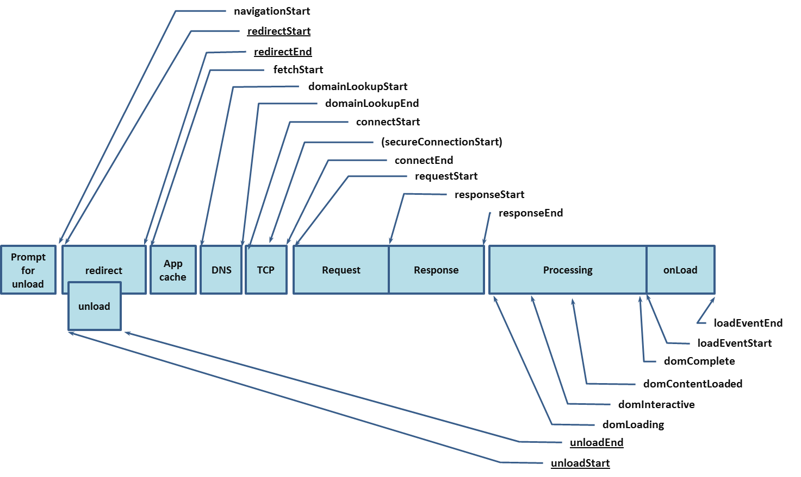
SPEED TEST
INTERACTIVE TIME
LOAD TIME
SOLUTION

Slide 53
SPEED TEST
2. Choose Speed Test
3. Choose Pages
Option
1. Login as Staff role
Page Option
Popup
Staff
Speed Test Page
4. Save
Page Option
Staff Page
5.Check Speed Test
6. Save Result
Check Result Table
Speed Test Page

Slide 54


JAVASCRIPT ERROR TEST
With a large and complex site, it is easy to introduce errors in your JavaScript code by accident.
We use real browsers to test every page, we experience JavaScript errors as we browse your website, just like a user would

Slide 55
JAVASCRIPT ERROR TEST
2. Choose JavaScript Test
3. Choose Pages
Option
1. Login as Staff role
Page Option
Popup
Staff
JavaScript Test Page
4. Save
Page Option
Staff Page
5. Check JavaScript
Test
6. Save Result
Check Result Table
JavaScript Test Page

Slide 56


SERVER BEHAVIOR TEST
Many websites have invisible configuration problems that undermine their SEO, usability and performance. With 3 standard that we determine:
The SSL of the website
The redirection from non-WWW to WWW
The redirection from http to https

Slide 57
03
OUTCOME
Value and Challenge

Slide 58

ASSESSMENT
VALUE
Test many things in one place.
Measure and improve the quality of website.
After finish test, staff can save and export the result as a report.
Staff can view old reports (View history report).
Evaluate the completeness of the website features.
Make website is greater and professional.
Notes:
Kiểm tra nhiều thứ ở một nơi.
Đo lường và nâng cao chất lượng của trang web.
Sau khi kiểm tra kết thúc, nhân viên có thể lưu và xuất kết quả dưới dạng báo cáo.
Nhân viên có thể xem các báo cáo cũ (Xem báo cáo lịch sử).
Đánh giá tính đầy đủ của các tính năng trang web.
Làm cho trang web lớn hơn và chuyên nghiệp.

Slide 59

ASSESSMENT
DISADVANTAGE
Only support for website in English.
Notes:
Hệ thống của chúng tôi chỉ hỗ trợ tiếng anh
Cần có internet để sử dung hệ thống chúng tôi.

Slide 60
04
FUTURE PLAN

Slide 61

FUTURE PLAN
Export all test report: system will export all result test.
Implement visualization of result test by charts.
The system will be scheduled to automatically test.
The system will allow user to select each function with defined input parameters.
Dynamically embed editor on webpage.
We design the system to analysis and evaluation based on test results of related reports.
Upgrade grammar test.
Notes:
Hệ thống chúng tôi có thể xuất tất cả kết quả cùng một lúc
Thể hiện kết quả kiểm tra bằng biểu đồ để người dùng dễ nắm bắt thông tin về website
Hệ thống có thể lập lịch cho hệ thống tự động kiểm tra theo chu kỳ
Cho phép ngừoi dùng định nghĩa các mẫu đầu vào cho các phần kiểm tra
Hệ thống có thể cho phép ngừoi dùng kiểm tra source code trược tiếp trên hệ thống
Phân tích và đánh giá dựa trên các kết quả liên quan
Nâng cấp hệ thống kiểm tra ngữ pháp

Slide 62
QUESTION
AND ANSWER

